Slide 1
Team Agile Robotic Control
Logan Beaver
Justin Campbell
Tyler Paddock
Ronald Shipman

Slide 2
Project Overview
Develop initial robotics platform
Public Outreach
Increase interest in STEM fields
Engineering deficit
Fluid Power
Educational robotics platform
Fluid Power
Control Systems
Robotics

Slide 3
Major Design Decisions
Quadruped Locomotion
Agile motion
Stable
Rugged Terrain
Pneumatic Power
High energy density
Clean and lightweight

Slide 4
Mechanical Design

Slide 5
Power Source Options
 | Advantages | Disadvantages
Hydraulic Power Source | -Highest achievable power density | -High maintenance -Heavy -Dirty
Electric Power Source | -Accurate positioning | -Lowest achievable power density -Noncompliant
Pneumatic Power Source | -Higher power density than electric power -Low Maintenance -Compliant action from fluid compression | -Compressible fluid causes inaccuracy in positioning

Slide 6
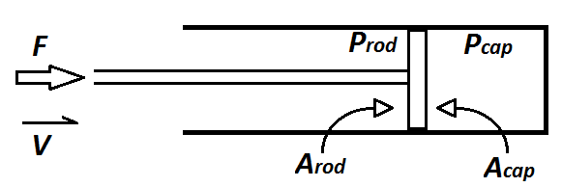
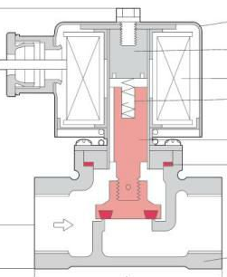
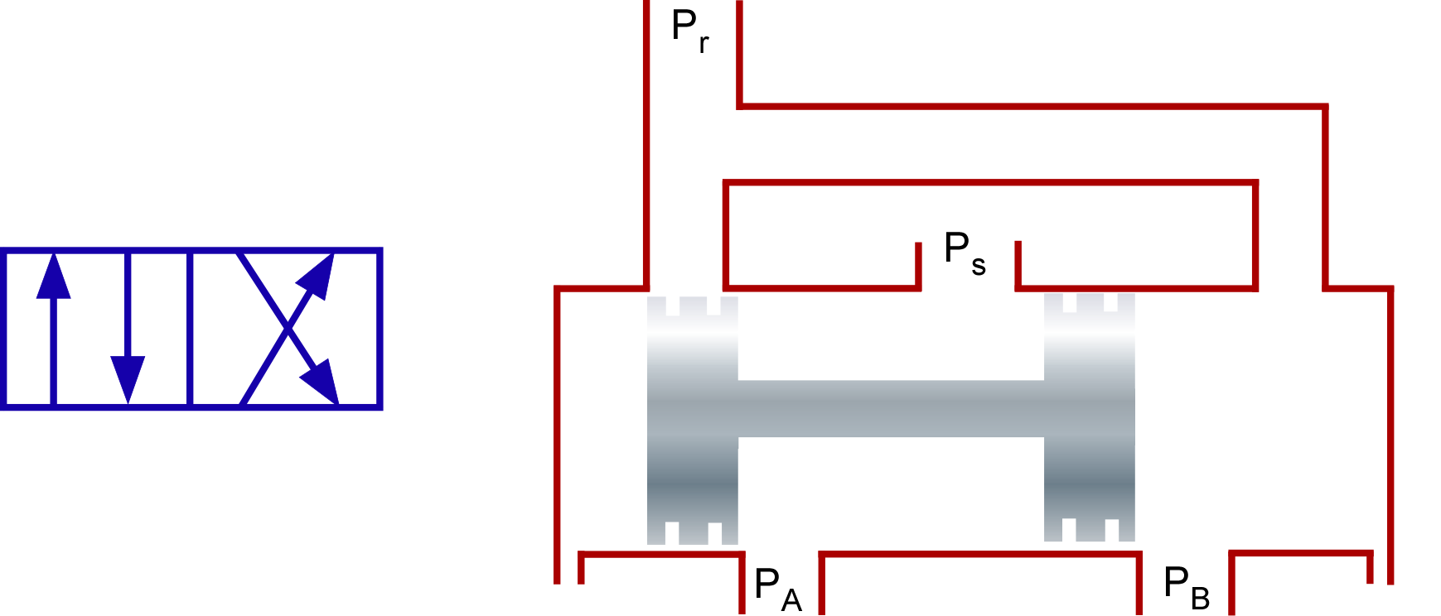

Components
Pneumatic components include:
Receiver Tank
Air Compressor
Double Acting Air Cylinders (w/ feedback)
Solenoid Valve
Directional Control Valves (4/2)
Pressure Relief Valve
Tubing
$$F =P_{cap}A_{cap} −P_{rod}A_{rod}$$

Slide 7
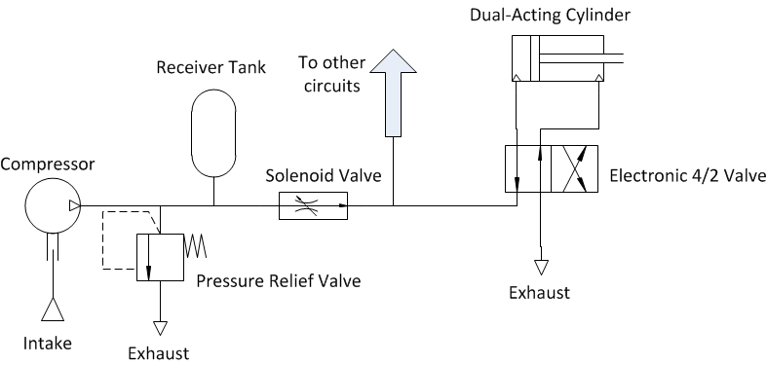
Pneumatic Circuit

Slide 8

Kinematic Modelling
Homogenous Transformations
Determines cylinder stroke
Shank X Acceleration:
$$\text{LH}\text{4*}\text{cos}\text{(}\text{tb}\text{)*}\text{tbdot}\text{^2 - }\text{LK}\text{4*}\text{cos}\text{(}\text{th}\text{4)*}\text{th}\text{4}\text{dot}\text{^2 + }\text{xddot}\text{ + }\text{LH}\text{4*}\text{tbddot}\text{*}\text{sin}\text{(}\text{tb}\text{) - }\text{LK}\text{4*}\text{th}\text{4}\text{ddot}\text{*}\text{sin}\text{(}\text{th}\text{4) - }\text{S}\text{4*}\text{tk}\text{4}\text{ddot}\text{*}\text{sin}\text{(}\text{tk}\text{4)}$$

Slide 9

Dynamic Model
$q=\left[\begin{aligned}\text{X} \\ \text{Y} \\ {\text{θ}}_{Body} \\ {\text{θ}}_{Hip 1} \\ {\text{θ}}_{Knee 1} \\ {\text{θ}}_{Hip 2} \\ {\text{θ}}_{Knee 2} \\ {\text{θ}}_{Hip 3} \\ {\text{θ}}_{Knee 3} \\ \begin{aligned}{\text{θ}}_{Hip 4} \\ {\text{θ}}_{Knee 4}\end{aligned}\end{aligned}\right]$
Lagrangian Mechanics
Non-inertial reference frames
Arbitrary global reference frame
Determines mechanical properties of components
27 Equations with state vector q

Slide 10
Control architecture
Control algorithms: Software implemented PIDs
Software: MATLAB/Simulink and associated CODER software
Simulink model of the control is developed and then C code is generated for the target hardware
Current hardware is an Arduino Mega 2560
The feedback in the control loop will be a position feedback from the cylinder

Slide 11
<Picture of Simulink model with PIDs>

Slide 12
Signal Conditioning
PWM signals from the microcontroller are filtered into analog signals to drive the pneumatic actuators
The analog signals will be scaled by amplifiers to the correct voltage required by the pneumatic actuator
Opto-isolators used to protect microcontroller by separating power circuits

Slide 13
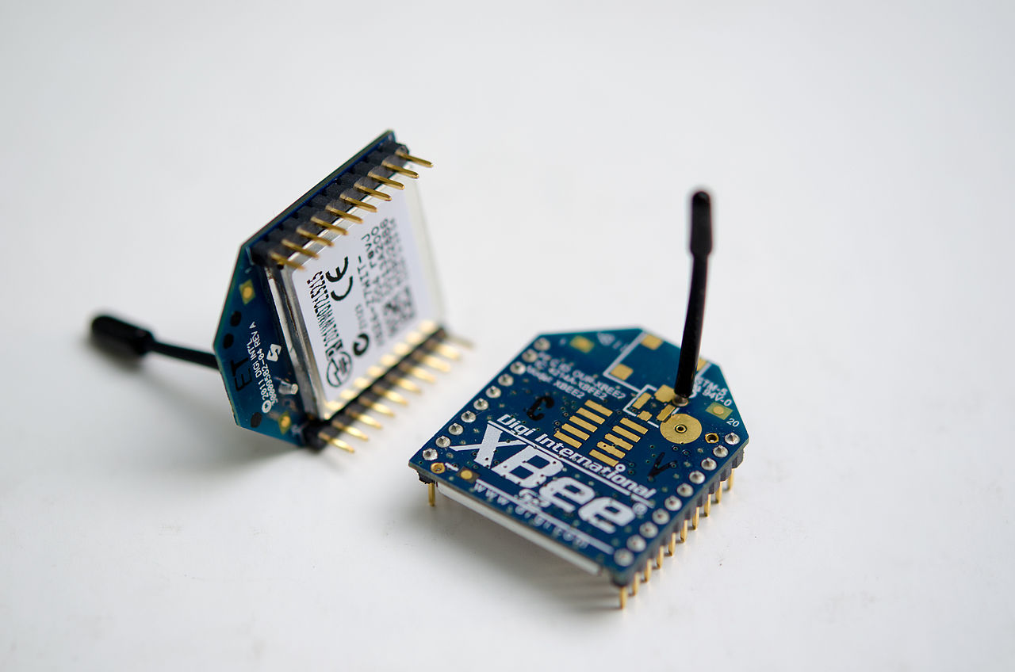
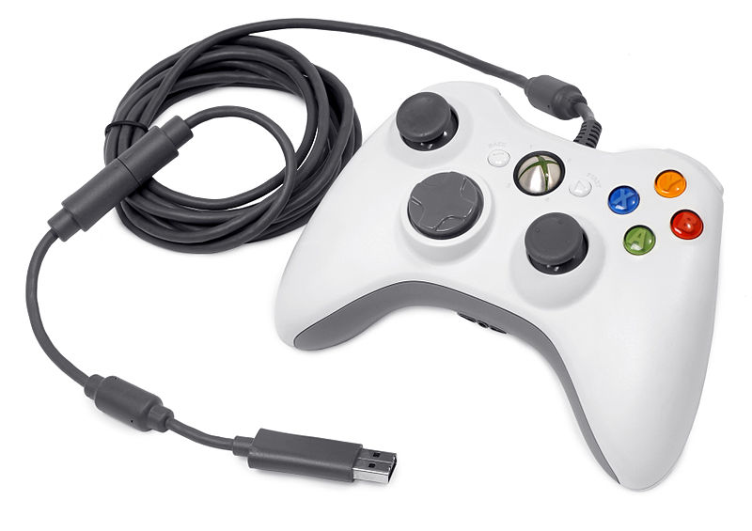
User Interface and Remote COntrol
Xbee short range radio devices using IEEE standard 802.15.4
Range: 100 meters
250Kbps maximum
2.4GHz operating frequency

Slide 14
What’s Next?
Determine necessary output forces of cylinders based on kinematic equations
Select appropriate pneumatic components based on needed specifications
Test air cylinders
Pneumatic circuit construction
Test circuit with control system

Slide 15
Questions?

